Slide 1
The Greater Wall PowerShell Framework
(Data analysis and Post Processing)

Slide 2
Querying Endpoints and Saving Data
Querying the endpoints
Invoke-command
Saving the output
>> or | out-file
CSV output and data consistency
Why is it important?

Slide 3
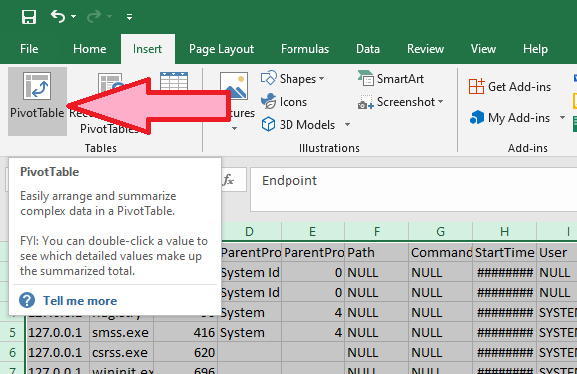
Pivot Tables
Pivot Tables
Highlight everything (with ctrl+a) and choose Insert -> Pivot Table
Click “OK” when the pop up box appears

Slide 4
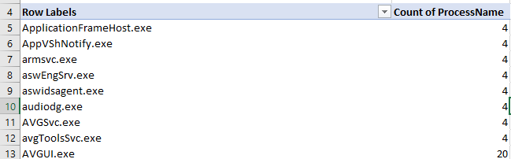
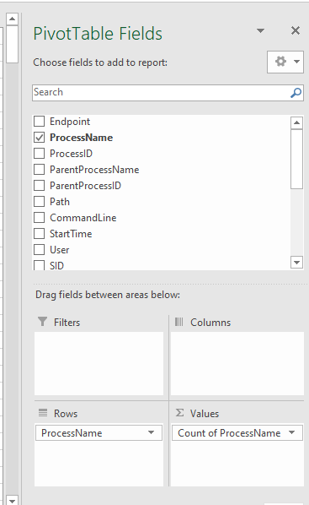
Pivot Tables
Pivot Tables
Drag and drop the selected property into “rows” and into “values”

Slide 5
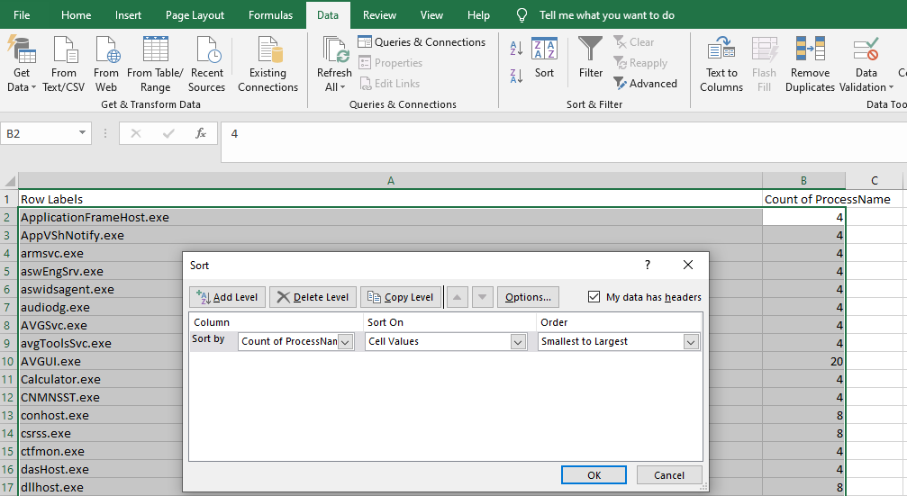
Pivot Tables
Pivot Tables
Copy and paste the table into a new sheet as plaintext
Data -> sort
By count, smallest to largest and click “ok”

Slide 6
Pivot Tables
Pivot Tables
Copy and paste the table into a new sheet as plaintext
Data -> sort
By count, smallest to largest and click “ok”

Slide 7
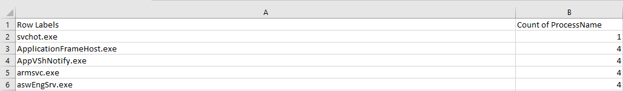
Pivot Tables
Pivot Tables
There’s your outlier
Now go back to the original document and ctrl+f for it to see what host it belongs to

Slide 8
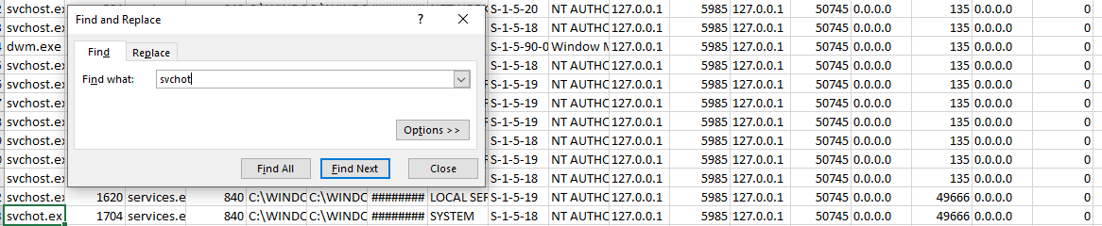
Pivot Tables
Pivot Tables
Host identified!

Slide 9
Conclusion
Conclusion
Useful but
Slow
Tedious
Painful
There’s gotta be a better way……

Slide 10
The Greater Wall PowerShell Framework
Modules
.pms1 modules that are dynamically loaded prior to execution and unloaded after execution
Framework will automatically recognize new modules
No need to tinker with source code of framework to add features

Slide 11
The Greater Wall PowerShell Framework
Rules for Creating Modules
Must be .pms1 file
Must contain a function that outputs a csv to stdout
Must contain export-modulemember –function <name_of_function> at end of code
Must be placed into the modules folder, inside of a folder that has the same name as the function
EX: C:\users\admin\Desktop\TheGreaterWall\Modules\Processes\Processes.psm1
Example Module
Function Demo-processes{
$output= @()
$output+= “name, location”
$proc= get-process
foreach ($p in $proc){
$name= $p.name
$location= $p.location
$output+= “$name,$location”
}
$output
}
Export-modulemember –function demo-processes

Slide 12
The Greater Wall PowerShell Framework
Exercise
Create a module, import it into TGW and run it against the remote hosts
Demo your module and the results

Slide 13
Data Analysis
Important Data
Choosing to collect the right data is key
Each category of data has a variety of additional properties
Ex: process information also contains information about the parent process
Not all data is important or distinguishable

Slide 14
Crashed Applications
Pivot field
The only field analyzed to determine outliers
Who cares if Microsoft.photos.exe crashed?
Who cares if Kernelbase32.dll is the faulting application?
BUT
Kernelbase32.exe being the faulting application for Microsoft.photos.exe is very specific
Simple concatenation
Timegenerated: 11/24/2020 14:25:25
FaultingApplicaiton: C:\Program Files\WindowsApps\Microsoft.Windows.Photos_2020.20090.1002.0_x64__8wekyb3d8bbwe\Microsoft.Photos.exe
FaultingModule: C:\WINDOWS\System32\KERNELBASE.dll
ParentChild: C:\Program Files\WindowsApps\Microsoft.Windows.Photos_2020.20090.1002.0_x64__8wekyb3d8bbwe\Microsoft.Photos.exe-C:\WINDOWS\System32\KERNELBASE.dll
Pivot field

Slide 15
New Process Created – Security 4688
Pivot field
The only field analyzed to determine outliers
All independently important
Important, informational but non-pivotable fields
InstanceId: 4688
Index: 32767
TimeGenerated: 11/28/2020 09:52:17
TimeWritten: 11/28/2020 09:52:17
ProcessName: C:\Windows\System32\WindowsPowerShell\v1.0\powershell.exe
ParentProcessName: C:\Program Files (x86)\Microsoft Office\root\Office16\WINWORD.EXE
Commandline:
ParentChildRelatoinship : C:\Windows\System32\WindowsPowerShell\v1.0\powershell.exe- C:\Program Files (x86)\Microsoft Office\root\Office16\WINWORD.EXE
Pivot Fields

Slide 16
PowerShell Logs
Obscure and almost non-pivotable fields
Message Field (the actual PowerShell stuff that occurred)
Ghetto Hash / Message hash
Mathematical computation
Based off the ascii character values of the relevant portion of the message contents
ID: 4104
RecordID: 1885
ProcessID: 11496
UserSID: S-1-5-21-3526336259-114047635-2714739378-1009
TimeCreated: 12/4/2020 8:33:12 AM
MessageHash: 95670

Slide 17
Post Processor
Reformat function
Modules.conf
Group-object
$output | Group-Object -Property $sortproperty | where {$_.count -le $numberofendpoints }).group)

Slide 18
Post Processor
Reformatting – It’s all about speed
Adds the endpoint field and strips headers prior to concatenation
Very important
Dataset 1
Endpoint, Processname,path
10.50.0.22,X,x
10.50.0.22, X,x
10.50.0.22, X,x
10.50.0.22, X,x
10.50.0.22, X,x
10.50.0.22, X,x
Concatenated Data set
Endpoint, Processname,path
10.50.0.22,X,x
10.50.0.22, X,x
10.50.0.22, X,x
10.50.0.22, X,x
10.50.0.22, X,x
10.50.0.22, X,x
Endpoint, Processname,path
10.50.0.23,X,x
10.50.0.23, X,x
10.50.0.23, X,x
10.50.0.23, X,x
10.50.0.23, X,x
10.50.0.23, X,x
Concatenated Data set
Endpoint, Processname,path
10.50.0.22,X,x
10.50.0.22, X,x
10.50.0.22, X,x
10.50.0.22, X,x
10.50.0.22, X,x
10.50.0.22, X,x
10.50.0.23,X,x
10.50.0.23, X,x
10.50.0.23, X,x
10.50.0.23, X,x
10.50.0.23, X,x
10.50.0.23, X,x
Dataset 2
Endpoint, Processname,path
10.50.0.23,X,x
10.50.0.23, X,x
10.50.0.23, X,x
10.50.0.23, X,x
10.50.0.23, X,x
10.50.0.23, X,x

Slide 19
Post Processor
Modules.conf
Needed by the post processor
Defines the new headers
Defines which fields will be considered pivot fields for each module
$env:userprofile\Desktop\TheGreaterWall\Modules\modules.conf

Slide 20
Post Processor
Group-object
Incredible speed
Get us what we need
Group-object example
$output | Group-Object -Property $sortproperty | where {$_.count -le $numberofendpoints }).group)
Concatenated dataset
Pivot Field
Total number of endpoints present in concatenated data set

Slide 21
Post Processor
Conclusion
Every New module needs
Entry in modules.conf
Straight forward syntax already obvious in modules.conf
Reformat function
Steal a reformat function form a different module and modify it accordingly

